Slide 1
Self-reported adherence data
Alex Dima, Ira Wilson, Marie Schneider

Slide 2
09:00-10:00 | Introduction to SR analysis | Alex Dima, Ira Wilson, Marie Schneider
 | Overview of SR tools in adherence measurement; principles of psychometrics, questionnaire development, choice and validation of tools.
10:00-10:45 | How to ask patients about their medication adherence? | Small group work
 | Practical exercise on question wording and strategies to improve data quality
10:45-11:00 | BREAK
11:00-12:00 | Demo R analysis SR tool | Alex Dima
 | Presentation of an R script for analyzing an example adherence SR tool; dataset provided.
12:00-12:45 | Run analysis on the SR dataset provided | Small group work
 | Participants will re-run the analysis demonstrated on their own computers and interpret & experiment with the script provided.

Slide 3
[insert slides Marie]

Slide 4
From clinical practice to research
We need numbers that capture the ‘right’ variation in adherence
Validity (reduce systematic variation due to other reasons)
Reliability (reduce random variation – when no change)
Responsiveness (capture relevant variation – when change)
internal validity external validity

Slide 5

Adherence questionnaires
…most for implementation
Mixed with non-persistence
Lacking/assuming initiation
To detail…
http://onlinelibrary.wiley.com/doi/10.1111/bcp.12194

Slide 6
doi: 10.1016/j.jclinepi.2010.02.006 https://cosmin.nl/
Notes:
Measurement properties and how they influence adherence scores – large literature in health sciences, recent international consensus on measurement properties focuses on these 3 domains, plus interpretability

Slide 7
What do we measure via SR?
Who?
patient
caregiver/parent
HCP
What?
actual use or ratio used/prescribed
determinants
How?
questionnaire (e-format/paper/F2F)
interview (phone/F2F)
Where?
online
care settings
To whom?
researcher-
clinician-
self-administered
Notes:
To state from the start that we’re not talking about a single type of measure, but quite a wide range of options – choices again make a difference to data quality
Already mentioned by Marie – check what overlap and what to change

Slide 8
What?
Actual use / prescribed (implementation)
e.g. « yesterday, how many pills… » (knowing prescribed quantity)
Estimation of adherence (implementation)
e.g. « I take it less than instructed » (always/often/sometimes/rarely/never)
… sometimes mixed with
Determinants of adherence – e.g. « when I feel…, I forget… »
→ TIP no.1: measure behaviour, separate determinants

Slide 9
Who?
Patient / caregiver / HCP
Check who has access to what information?
Parent might administer medication or not
HCP might estimate based on health status (outcomes)
Patient might not be aware if not self-administered
Check who is available and willing to respond?
→ TIP no.2: balance response rate & response bias

Slide 10
How/Where/To whom?
Context matters:
→ TIP no.3: make it accessible, credible, short, safe
A face to face interview by a nurse in the waiting room of the outpatient center before the consultation.
I forget to take the medicine | “always” to “never” 1-5 points; total score 5-25; MARS-5 © Rob Horne
I alter the dose of medicine
I stop taking the medicine for a while
I decided to miss out a dose
I take less than instructed
An online questionnaire self-completed by the patient on a tablet in the research laboratory after a cognitive test administered by a psychologist.

Slide 11
Determinants of data quality
INTERVIEWER
Enthusiastic about the study
Prompt response
Friendly and polite
Well informed
Explains clearly
Understands and adapts to participant
Records responses carefully
PARTICIPANT
Interesting study
Professional team
Pleasant chat
Clear what to do
Easy to do
Flexible procedure
Finds time
Engages with the task
Provides accurate & complete responses
RESEARCH AIMS
Accurate answers to research questions
QUALITY DATA
To check…
Notes:
Can include plot with variation of adherence depending on interviewer

Slide 12
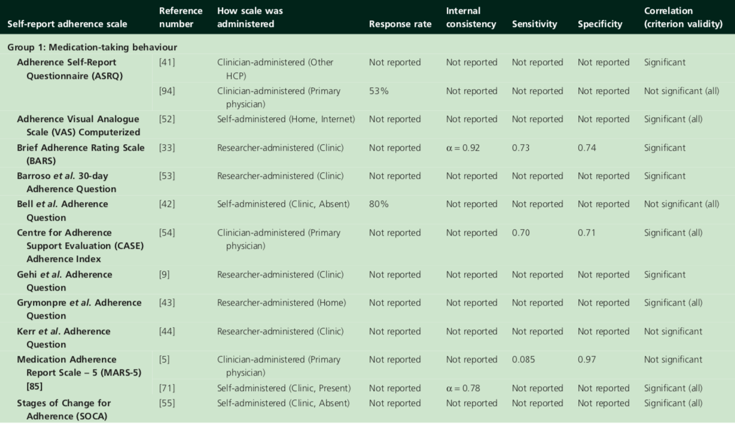
http://onlinelibrary.wiley.com/doi/10.1111/bcp.12194
Notes:
Discuss several questionnaires + pros&cons

Slide 13
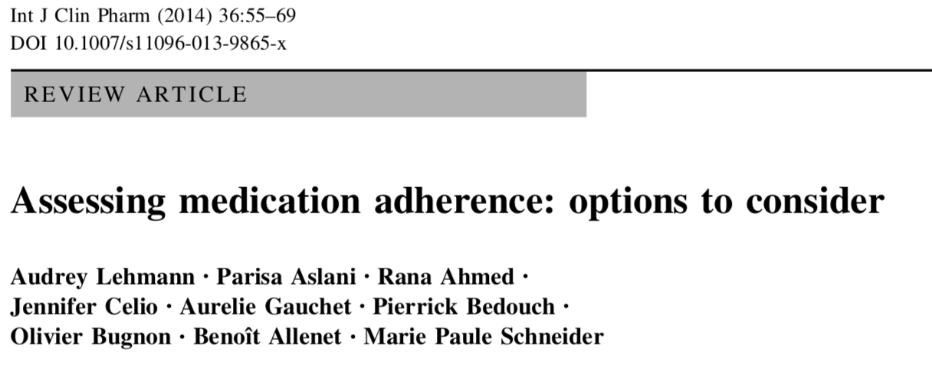
SR versus others
Several options of self-report, review pros and cons compared to other sources
To detail…

Slide 14
What’s in a question?
Comprehension
Retrieval
Judgment
Response
Theory of survey response
Notes:
To check with Ira if OK to present this here or better in qre development example

Slide 15
Interviewer-administered
Comprehension
Get/keep attention
Speak clearly and slowly
Check understanding
Retrieval
Memory aids
Probe for missing info
Judgment
Help integrate material retrieved
Suggest approximation strategies
Response
Map judgment on response categories (interviewer or patient)

Slide 16
Self-administered
Comprehension
Clear instructions
Simple words
Easy short sentences
Retrieval
Define recent period
Ask concrete info
Judgment
Don’t ask for complex calculations
Normalize behaviour
Response
Clear non-overlapping response categories
Avoid double negations
response categories fit the questions wording
Recall bias
Desirability

Slide 17
Example 1
MARS-5 (Medication Adherence Report Scale)
‘Many people find a way of using their medicines which suits them. This may differ from the instructions on the label or from what their doctor had said. Here are some ways in which people have said they use their medicines. For each statement, please tick the box which best applies to you’
(MARS-9; Horne & Weinman, 2002; https://doi.org/10.1080/08870440290001502)
Desirability
Recall bias?
I forget to take the medicine | “always” to “never” 1-5 points; total score 5-25; MARS-5 © Rob Horne
I alter the dose of medicine
I stop taking the medicine for a while
I decided to miss out a dose
I take less than instructed
No time interval specified
Multiple forms available
(item no., admin, med,
condition..)
Notes:
The time is missing, not reported in many papers

Slide 18
Example 2
ProMAS (Probabilistic Medication Adherence Scale)
it has happened at least once that i forgot to take (one of) my medicines. (r) | yes/no; 18 items; taking and timing; different time intervals; different medications
it happens occasionally that i take (one of) my medicines at a later moment than usual. (r)
I have never (temporarily) stopped taking (one of my) medicines.
it has happened at least once that I did not take (one of) my medicines for a day. (r)
I am positive that i have taken all the medication that I should have taken in the previous year.
I take my medicines exactly at the same time every day.
I have never changed my medicine use myself.
…
To detail…
http://dx.doi.org/10.2147/PPA.S76749
Notes:
The time is missing, not reported in many papers

Slide 19
Example 3
Extent of Adherence (Voils et al 2012)
In order for blood pressure medication to work, people have to take it according to their doctor’s instructions. For one reason or another, people can’t or don’t always take all of their pills as prescribed. We want to know how often you have missed your blood pressure medication. Please rate your agreement with the following statements.
Desirability
Recall bias?
Over the past 7 days…
I took all doses of my …medication (r). | 5-point “SA”-“SD” total score non-adherence average;
I missed or skipped at least one dose of my …medication
I was not able to take all of my … medication
To detail…
doi: 10.1097/MLR.0b013e318269e121
Notes:
The time is missing, not reported in many papers

Slide 20
Example 4
Morisky? At all?
To detail…
Notes:
The time is missing, not reported in many papers

Slide 21
Example 5
MIS-A?
To detail…
Notes:
The time is missing, not reported in many papers

Slide 22
How to choose a measure?
Link with the ABC taxonomy and operationalisation
What medication?
What stage?
What timeline?
Who can answer?
How do they answer? – TSR 4 steps (face validity)
Measurement properties
Overlap & timing with determinants or outcomes
(Copyright/Permission)

Slide 23
Development or adaptation?
Language (back-translation & cultural adaptation)
Respondent (patient vs caregiver vs HCP)
Medication regimen (dosage, form of administration)

Slide 24
10 rules for SR
1. Do not reinvent the wheel | SR validated for target population if possible.
2. Define the construct of interest | Select SR items matching the construct
3. Chose computer vs F2F | reduce social desirability & improve data quality
4. Separate data collection from adherence support | reduce social desirability
5. Normalize nonadherence | intro statement to reduce social desirability
6. Choose ordinal or continuous response format | may help reduce ceiling effects
7. Specify a recall period; tailor to respondents capacities | last 30 days may reduce ceiling effects relative to shorter intervals
8. If dichotomizing, try 100 % | takes into account the tendency for over-reporting
9. Add a social desirability measure | complements analysis of SR adherence
10. Report measure, administration method, descriptives | help evidence synthesis
To check…
Stirratt et al. 2015; doi: 10.1007/s13142-015-0315-2

Slide 25
[insert slides Ira]

Slide 26
Item stem
Recall – time frame
Response categories/options

Slide 27
Key messages
Don’t develop a new measure unless you have to!
Time consuming
Complicated…
Don’t use ‘de facto’ scales if they don’t fit the criteria/your situation
If you do develop, make sure you follow the process

Slide 28
Exercise 1
Individual questions (cognitive testing)
→ Examine the example questions:
- what difficulties in responding?
- what improvements?

Slide 29
Exercise 2
Improve data quality by changing context:
mHealth → digital tools for adherence measurement
How to use it to improve response
(example of measuring adherence in a clinical setting as part of the study)
EMA, micromoments, other options (link with interventions…)
Notes:
Heidi Crane Seattle – UoW → digital tools for adherence measurement
Richard Lester – British Columbia →

Slide 30
Self-reported adherence data
Demo self-report measure analysis
Alex Dima

Slide 31
How to choose a measure?
doi: 10.1016/j.jclinepi.2010.02.006 https://cosmin.nl/
Notes:
Measurement properties and how they influence adherence scores – describe in a few slides

Slide 32
Reliability of SR
Reliability
test-retest : answers today == in e.g. 1 week
!! different period over time with no change
inter-rater: answers carer 1 == carer 2, same occasion
intra-rater: answers same person, occasion 1 == occasion 2
Internal consistency:
item set 1 == item set 2, same period
Measurement error:
systematic + random variance not due to ‘true’ differences

Slide 33
Validity of SR
Content
Face validity: does it ask about adherence?
Construct
Structural: uni/multidimensional == construct dimensions
Hypothesis-testing: in line with expectations on adherence relationships (convergent/discriminant/known groups)
Cross-cultural: e.g. French version behaves as English version
Criterion:
SR adherence score reflects ‘gold standard’ (EM? EHD?)

Slide 34
Responsiveness & interpretability
Responsiveness:
Distinguish clinically important changes in adherence e.g. due to an intervention (e.g. trials) or changes in determinants (e.g. observational studies)
!! Consider distribution (ceiling effects)
Interpretability:
Can you still assign qualitative meaning? Which?
80% percentile adherence questionnaire (BEH+DETs)
NOT== 80% doses taken from prescribed
!! Beware of normalising skewed distributions

Slide 35
How to choose a measure?
Most adherence SR scales:
internal consistency
criterion – often sensitivity/specificity (diagnostic?)
Less reported:
test-retest
Inter-rater
construct
hypothesis-testing
Notes:
Measurement properties and how they influence adherence scores – describe in a few slides

Slide 36
Data analysis for SR
Data preparation
Checks of data quality
Descriptives item level
Calculating scores and descriptives scale level
Psychometrics checks:
Internal consistency
test-retest reliability
criterion validity
Hypothesis-testing
Advanced resource: https://www.tandfonline.com/doi/full/10.1080/21642850.2018.1472602

